Slide 1
NITOC Double-Elimination Outrounds
Wayne Johnson

Slide 2
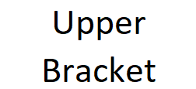
NITOC Double-Elimination Outrounds

Slide 3
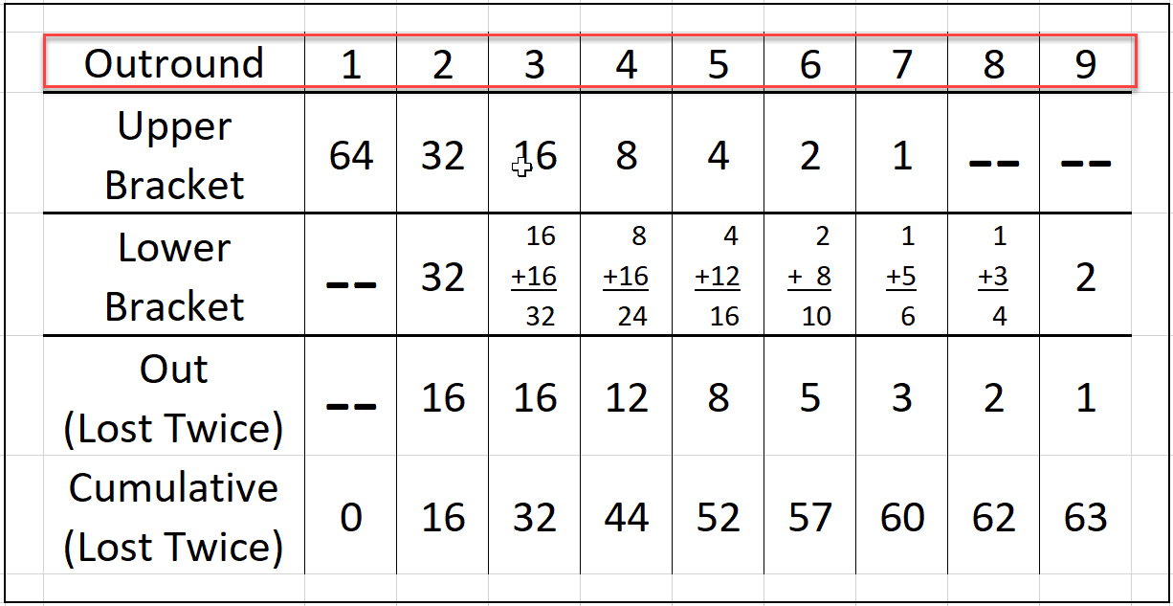
NITOC Double-Elimination Outrounds

Slide 4
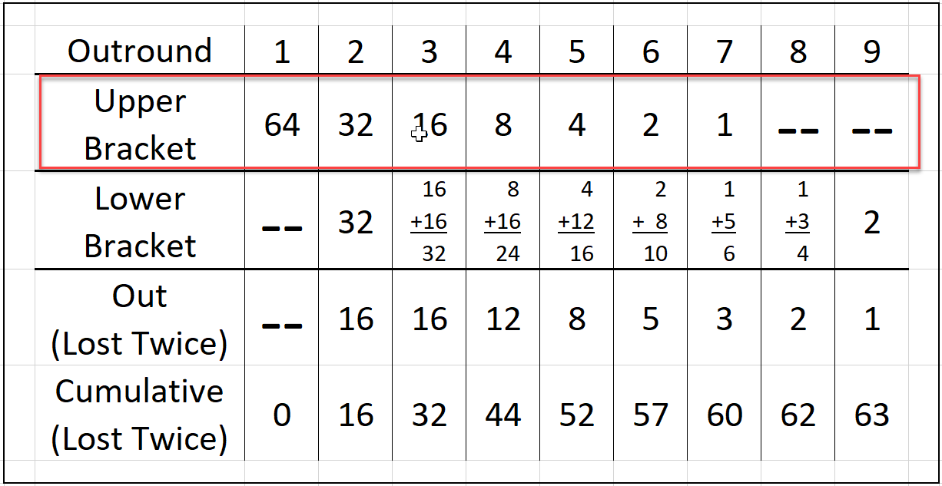
NITOC Double-Elimination Outrounds

Slide 5
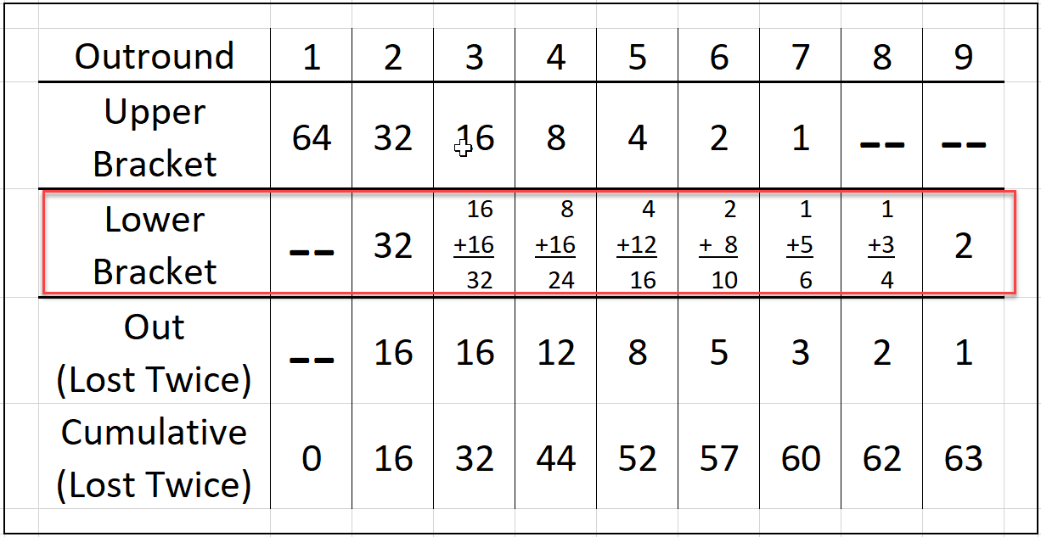
NITOC Double-Elimination Outrounds

Slide 6
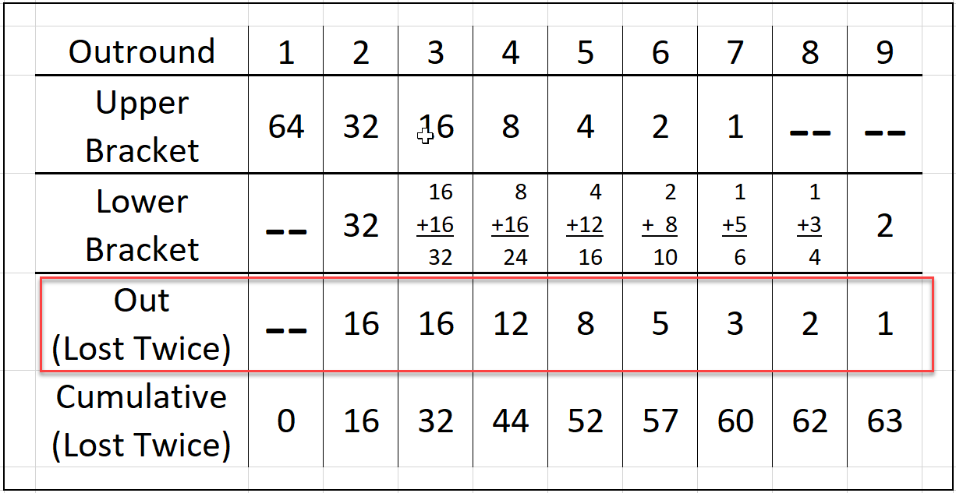
NITOC Double-Elimination Outrounds

Slide 7
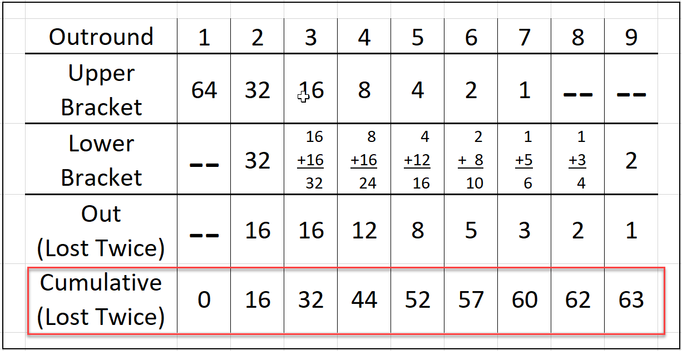
NITOC Double-Elimination Outrounds

Slide 8
NITOC Double-Elimination Outrounds

Slide 9
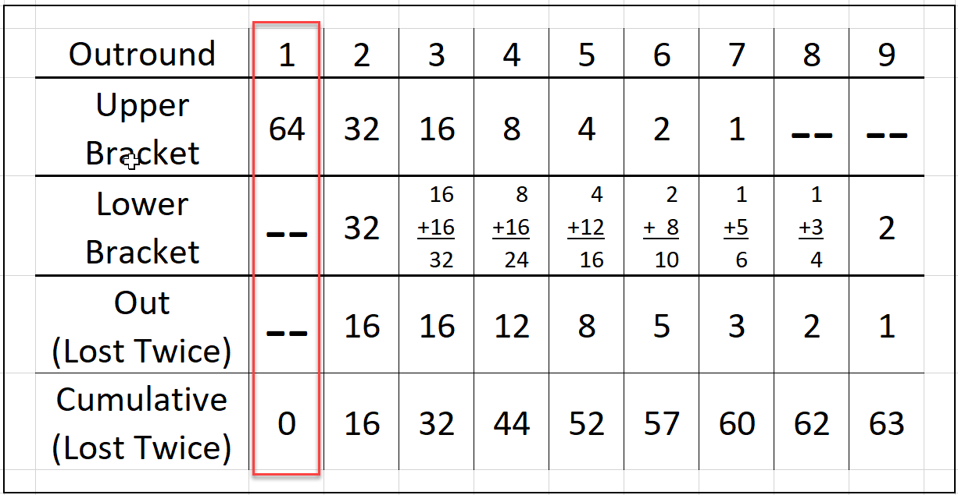
NITOC Double-Elimination Outrounds

Slide 10
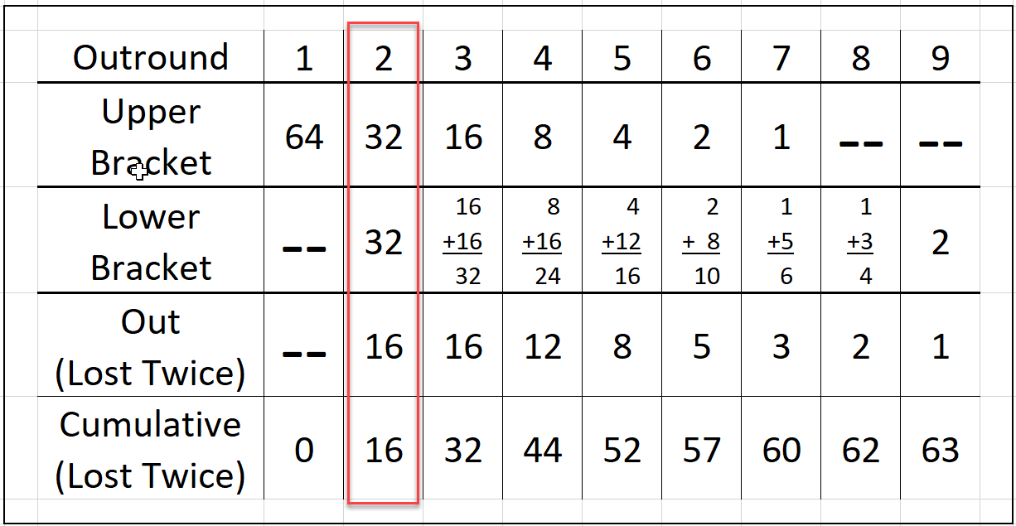
NITOC Double-Elimination Outrounds

Slide 11
NITOC Double-Elimination Outrounds

Slide 12
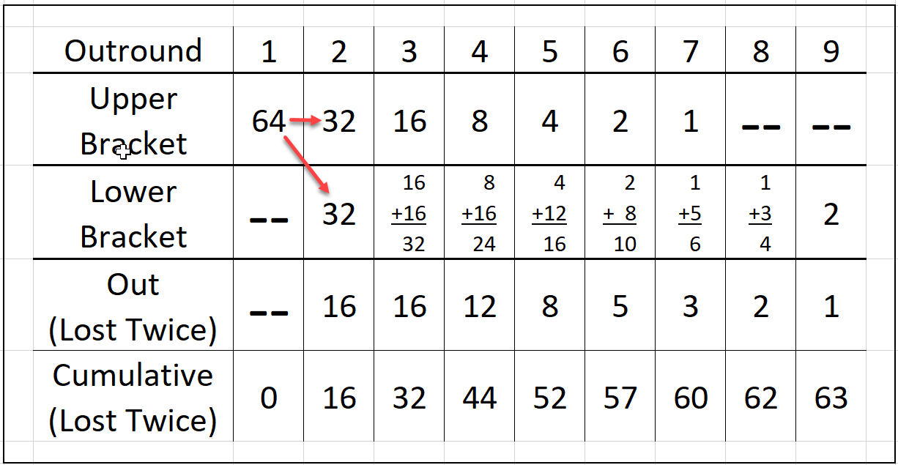
NITOC Double-Elimination Outrounds

Slide 13
NITOC Double-Elimination Outrounds

Slide 14
NITOC Double-Elimination Outrounds

Slide 15
NITOC Double-Elimination Outrounds

Slide 16
NITOC Double-Elimination Outrounds

Slide 17
NITOC Double-Elimination Outrounds

Slide 18
NITOC Double-Elimination Outrounds

Slide 19
NITOC Double-Elimination Outrounds

Slide 20
NITOC Double-Elimination Outrounds

Slide 21
NITOC Double-Elimination Outrounds

Slide 22
NITOC Double-Elimination Outrounds

Slide 23
NITOC Double-Elimination Outrounds
NITOC
Winner

Slide 24
NITOC Double-Elimination Outrounds
NITOC
Winner

Slide 25
NITOC Double-Elimination Outrounds

Slide 26
NITOC Double-Elimination Outrounds
Wayne Johnson

